Slide 1









SECP3133
HIGH PERFORMANCE DATA PROCESSING
PROJECT 2: REAL-TIME SENTIMENT ANALYSIS USING APACHE SPARK AND KAFKA
GROUP G
MUHAMMAD DANIAL BIN AHMAD SYAHIR A22EC0206
NAVACHANDER NAVASANTAR A22EC0226
NADHRAH NURSABRINA BINTI ZULAINI A22EC0224
LOW JIE SHENG A22EC0075

Slide 2




INTRODUCTION
01
02
03
Project Goal
Focus Area
Key Pipeline Steps
Data Ingestion: Stream game review data into Kafka.
Data Processing & NLP: Clean and process reviews using NLP techniques.
Sentiment Classification: Use ML/DL models for sentiment analysis (positive, negative, neutral).
Real-Time Visualization: Display insights on an interactive Tableau dashboard.
Develop a real-time sentiment analysis system using Apache Spark and Kafka for big data processing and streaming.
Analyze user sentiments from Steam reviews for popular games like Counter-Strike 2 and Dota 2.
Gain insights into player perceptions of these games.

Slide 3
DATA ACQUISITION & PREPROCESSING
01
02
03
Data Source
Tools USed
Preprocessing Steps
Steam reviews collected using the Steam API
Popular games: Dota 2, Counter-Strike 2, GTA V, etc.
Python (Pandas, Regex, TextBlob)
NLTK for text cleaning
Kafka for real-time streaming
Lowercasing
Removing punctuation
Tokenization
Stopword removal
Stemming

Slide 4




SENTIMENT MODEL DEVELOPMENT
🔍 Training & Evaluation
🧪 Models Used
Naive Bayes (Traditional ML)
Uses TF-IDF vectorization
Simple, fast, lightweight
LSTM (Deep Learning)
Uses tokenization + padded sequences
Can learn context from word order
Dataset split: 80% training, 20% testing
Metrics: Accuracy, Precision, Recall, F1-score
Tools: Scikit-learn (NB), TensorFlow/Keras (LSTM)

Slide 5
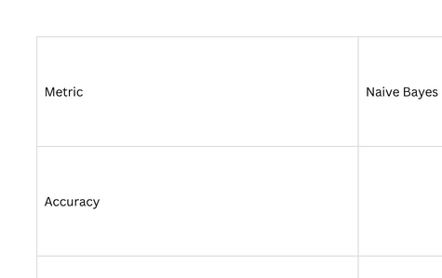
MODEL RESULTS (SUMMARY)
✅ Naive Bayes is more balanced and reliable.
⚠️ LSTM missed all negative reviews.

Slide 6
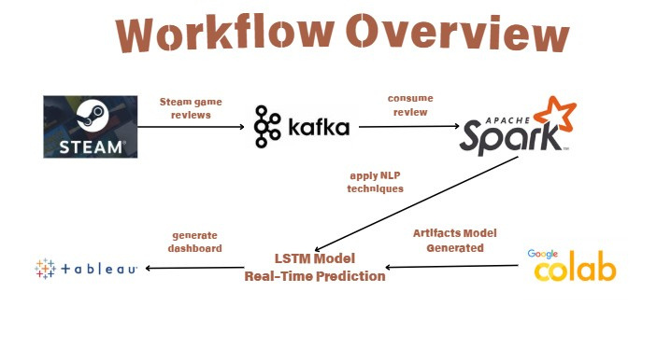
WORKFLOW OVERVIEW

Slide 7
APACHE KAFKA: REAL-TIME DATA INGESTION
Objective:
High-throughput, fault-tolerant streaming platform; central nervous system for data flow.
Advantages:
Decoupling: Producers and consumers operate independently, providing flexibility in system architecture.
Backpressure Handling: Efficiently manages varying data ingestion rates, ensuring smooth flow.
Data Durability: Messages are persisted on disk, preventing data loss even in case of system failures.
Scalability: Supports multiple consumers and producers, ensuring that the system scales as the data grows.
Key Component:
Producers: The Kafka producer consumes the raw Steam review data (CSV) and publishes it as messages to Kafka topics.

Slide 8
APACHE SPARK STREAMING: REAL-TIME DATA PROCESSING
Objective:
Scalable, high-throughput, fault-tolerant processing of live data streams.
Advantages:
Scalable: Handles large data volumes across clusters, making it suitable for big data processing.
Fault Tolerance: Minimizes data loss during system failures, ensuring high reliability.
Real-time Processing: Processes live streams quickly, ensuring that insights are up-to-date.
Unified Engine: Supports batch processing, streaming, machine learning, and graph workloads, providing flexibility for various applications.
Key Components:
Consumers: The Spark Streaming application subscribes to the Kafka topic (steam_reviews) to pull the data and process it.
Processing Model: Processes data in micro-batches (or continuously for lower latency), applying necessary NLP techniques like tokenization, sentiment classification, and feature generation.

Slide 9
DATASET OVERVIEW
game name – Name of the Steam game
review – Review text (cleaned)
voted_up – Whether review is upvoted (True/False)
timestamp – Date/time of review
platform – Only Steam
sentiment – Labeled as positive, neutral, or negative

Slide 10
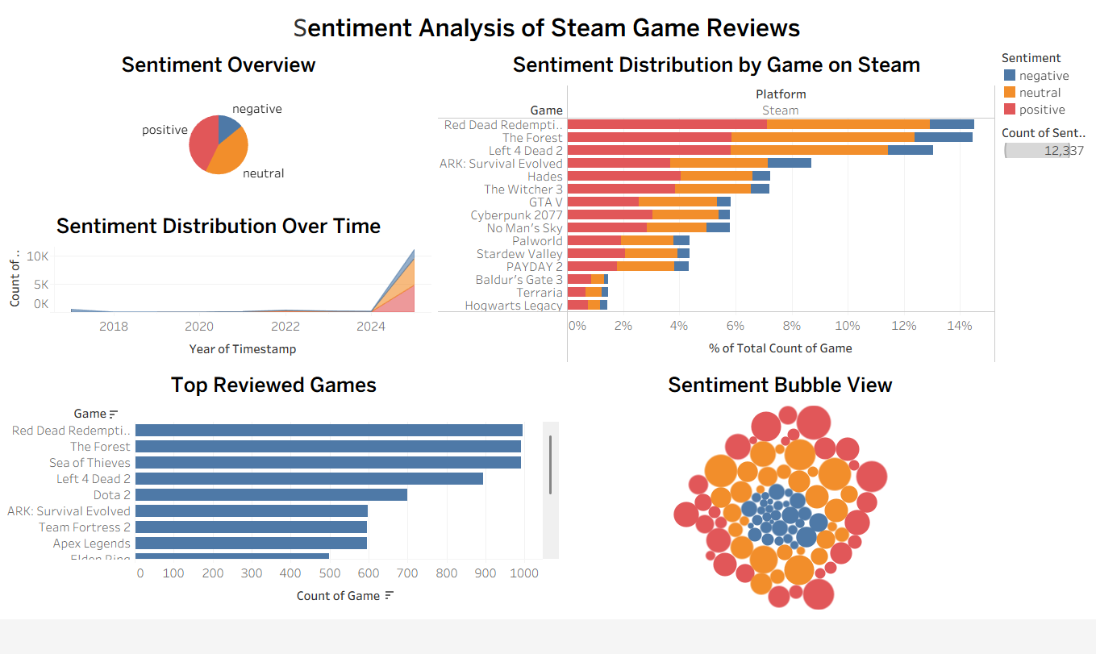
DASHBOARD

Slide 11
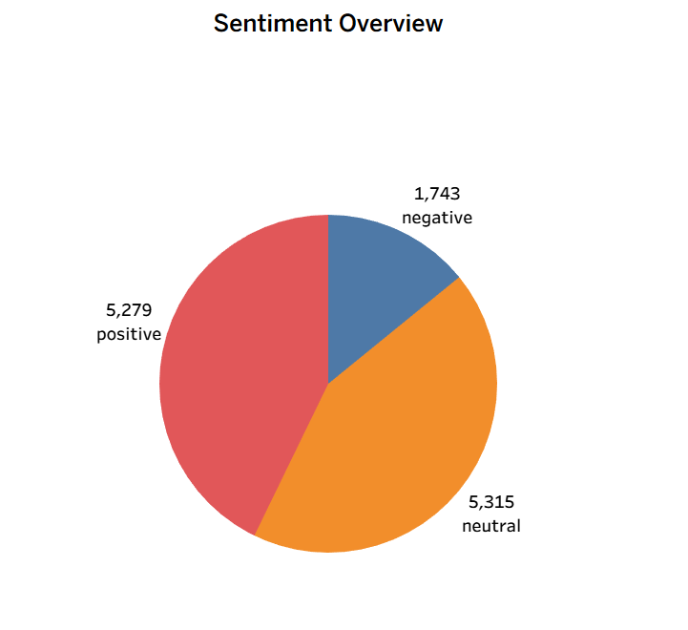
SENTIMENT DISTRIBUTION

Slide 12
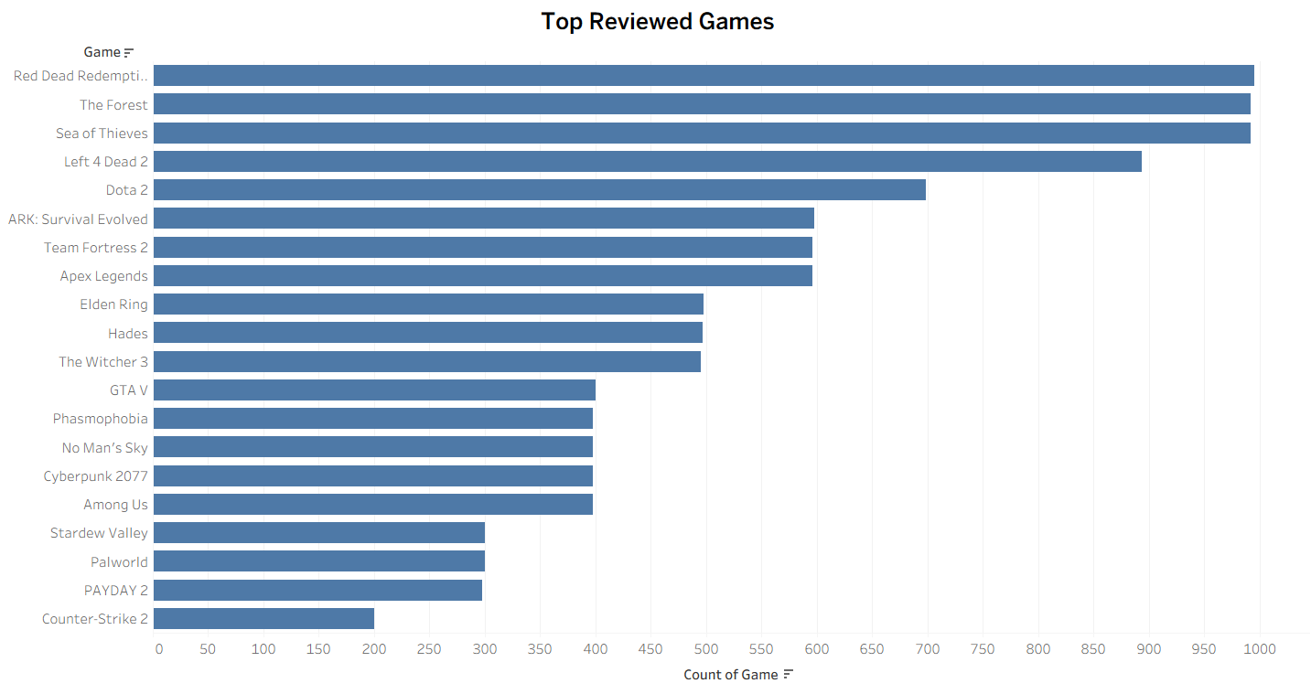
TOP REVIEWED GAMES

Slide 13
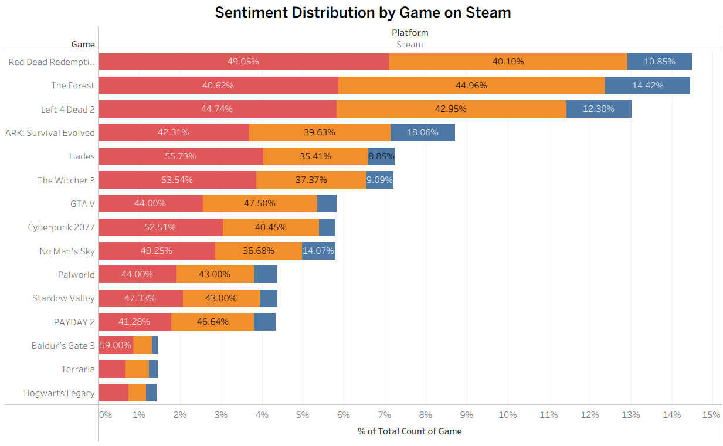
SENTIMENT BREAKDOWN BY GAME

Slide 14
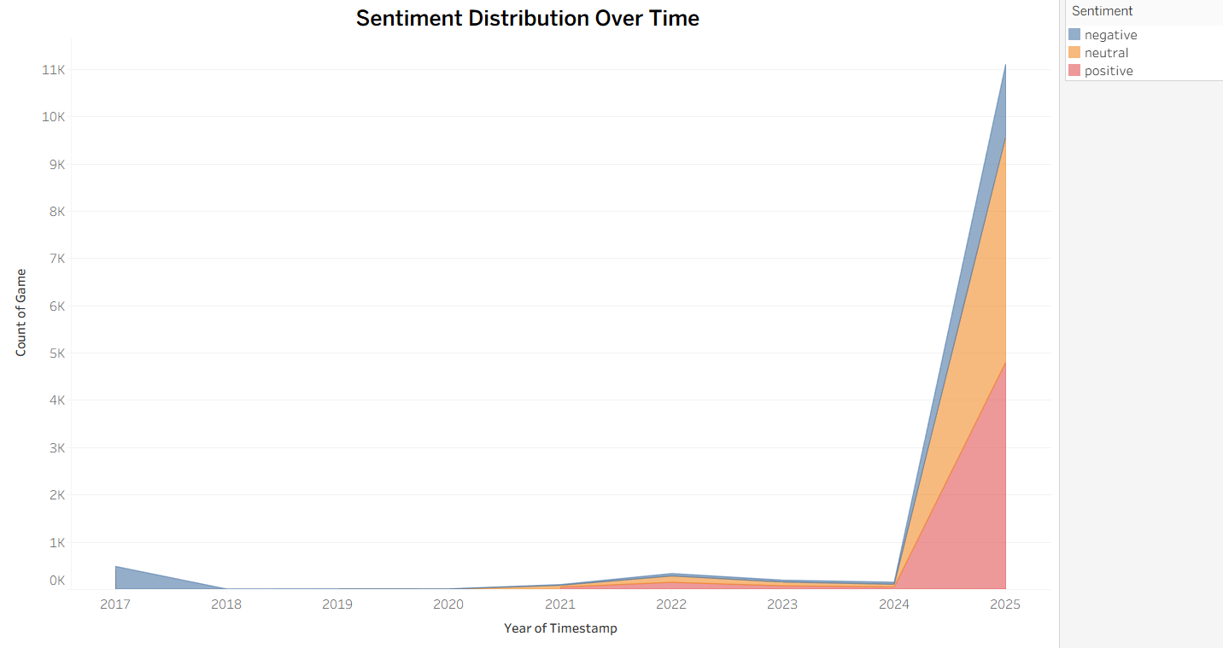
SENTIMENT TRENDS OVER TIME

Slide 15
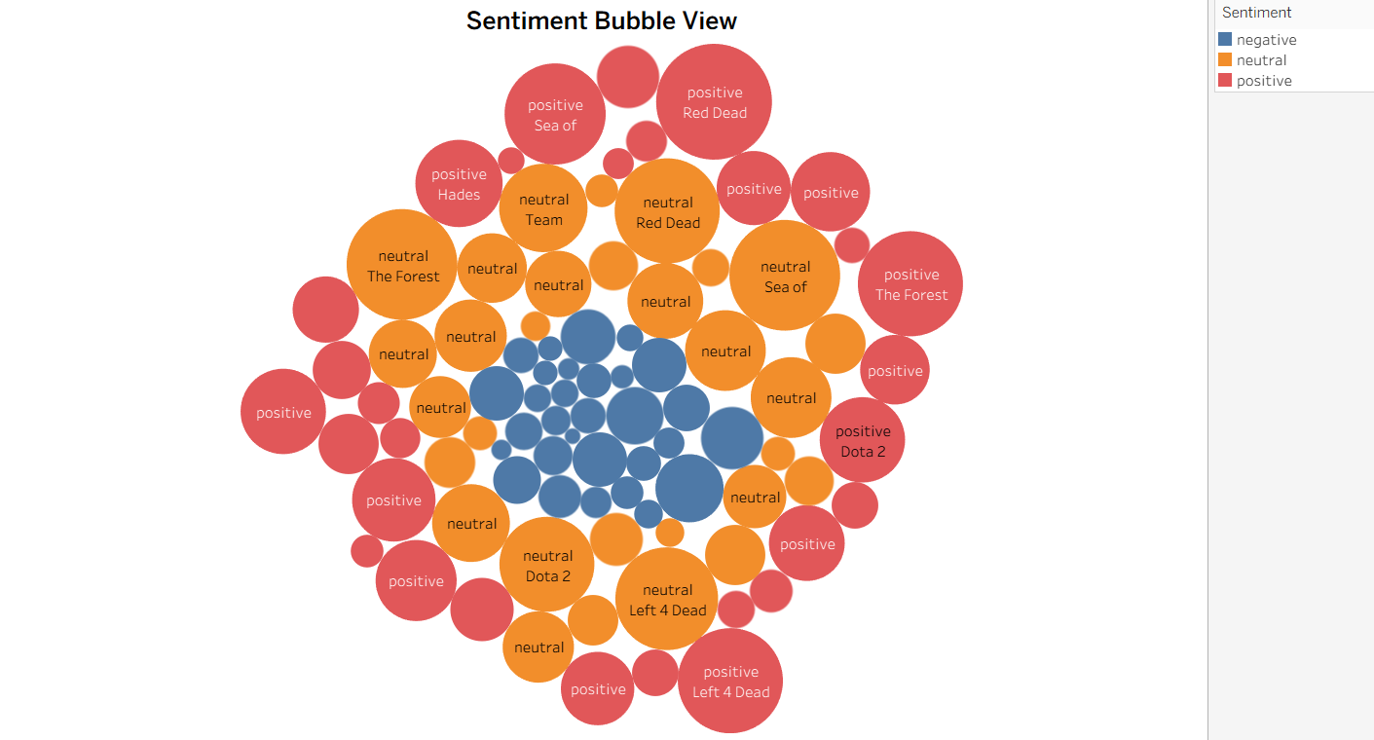
SENTIMENT BUBBLE VIEW BY GAME

Slide 16
KEY TAKEAWAYS FROM THE DASHBOARD
✅ Majority of reviews are positive
🔍 Most users express satisfaction with the games.
⚖️ Some games show mixed sentiments
📉 Helps identify games with both love and hate reactions.
📅 Sentiment trends change over time
🔔 Peaks and dips align with major events

Slide 17
MODEL COMPARISON
MODEL | NAIVE BAYES | LSTM
USAGE | Typically for batch processing, shown with limited streaming performance | Designed for real-time data processing, better for interactive deep learning tasks
STRENGTH | Simplicity and Speed: Fast to train, low computational cost, balanced results for positive and negative classes | Contextual Understanding: Learns word order and context, higher accuracy potential especially for nuanced text
WEAKNESS | Assumption of Independence: Cannot capture relationships between words, leading to weaker performance in complex sentences | Computational Cost: Requires more resources for training and inference, risk of class imbalance affecting predictions (e.g. missed negative reviews)

Slide 18
MODEL OPTIMIZATION
MODEL | NAIVE BAYES | LSTM
PRIMARY FOCUS | Speed and resource efficiency; reliable baseline performance | Accuracy maximization; contextual understanding in text
ADVANTAGE | Faster training, lower computational overhead, good for quick deployment | Better understanding of complex and nuanced text, adaptable to new data
CHALLENGE | Limited ability to handle complex language patterns due to independence assumption | Higher computational cost, requires larger balanced datasets, missed negative reviews in current setup
OPTIMIZATION STRATEGY | Feature engineering (n-grams), combining with sentiment lexicons, simple model tuning | Data balancing (increase negative reviews), hyperparameter tuning, integrating pre-trained embeddings (Word2Vec, GloVe), exploring BERT or Bi-LSTM, adjusting epochs and layers

Slide 19
THANK YOU

